Slide 1
Models of the motor system
Fall 2021
Opher Donchin

Slide 2
Part 1
Analyzing whole body movements

Slide 3
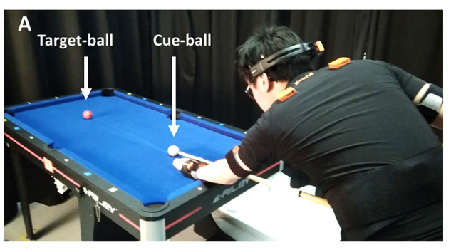
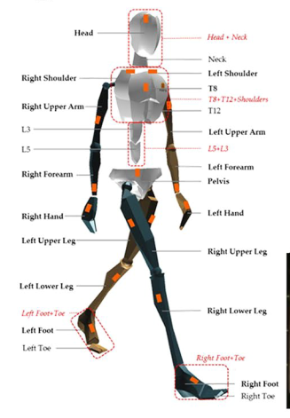
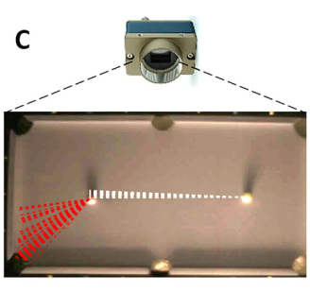
Measuring a whole body movement
Haar Scientific Reports 2020 doi:10.1038/s41598-020-76805-9

Slide 4

The complexity of whole body movement
drpopeyee New style LED dance performance
https://www.youtube.com/watch?v=J77-euN2OVw

Slide 5
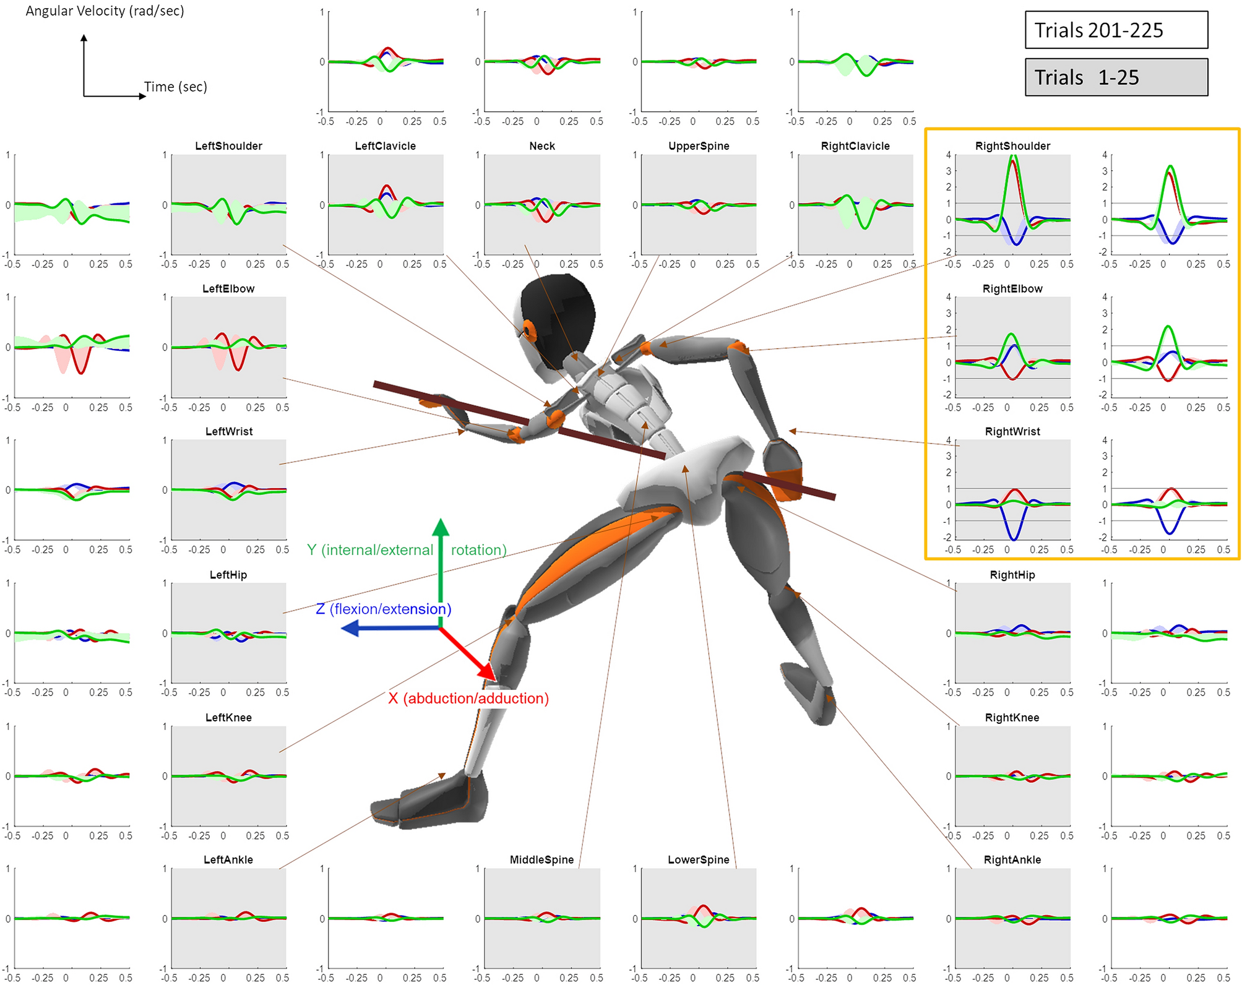
Billiards shots are whole body movements
Haar Scientific Reports 2020 doi:10.1038/s41598-020-76805-9

Slide 6
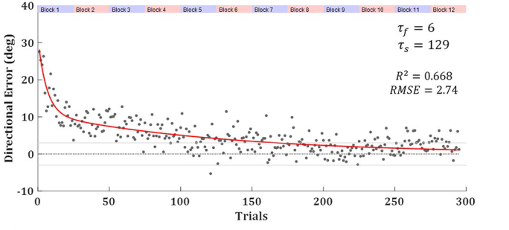
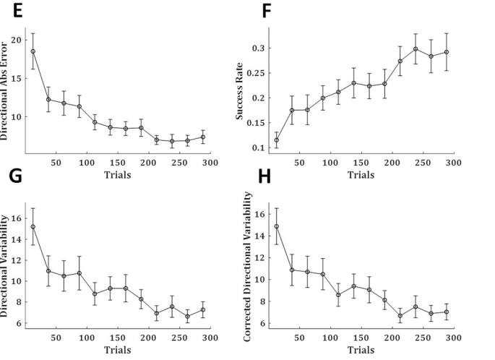
Learning billiards
Haar Scientific Reports 2020 doi:10.1038/s41598-020-76805-9

Slide 7
Learning changes multiple joints
Haar Scientific Reports 2020 doi:10.1038/s41598-020-76805-9

Slide 8
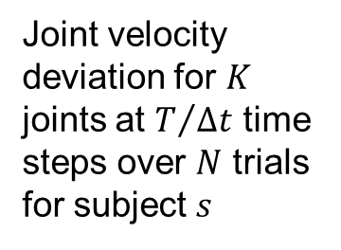
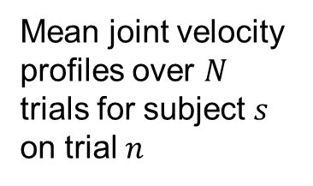
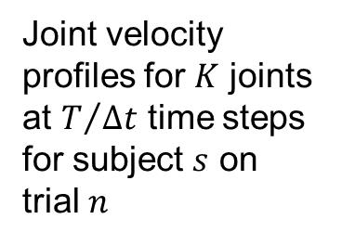
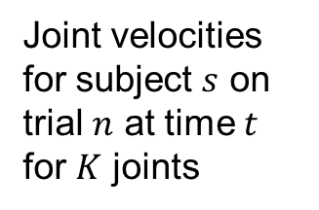
The data matrix
Joint velocities for subject $s$ on trial $n$ at time $t$ for $K$ joints
Joint velocity profiles for $K$ joints at $T/{Δt}$ time steps for subject $s$ on trial $n$
Mean joint velocity profiles over $N$ trials for subject $s$ on trial $n$
Joint velocity deviation for $K$ joints at $T/{Δt}$ time steps over $N$ trials for subject $s$

Slide 9
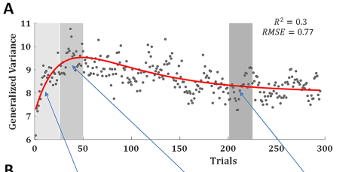
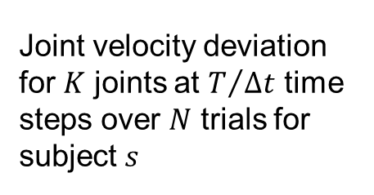
Generalized variance
Joint velocity deviation for $K$ joints at $T/{Δt}$ time steps over $N$ trials for subject $s$
The covariance matrix
The generalized variance
Haar Scientific Reports 2020 doi:10.1038/s41598-020-76805-9

Slide 10
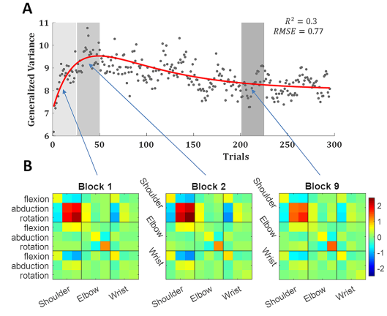
Looking at the covariance matrix
Haar Scientific Reports 2020 doi:10.1038/s41598-020-76805-9

Slide 11
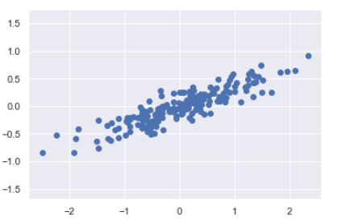
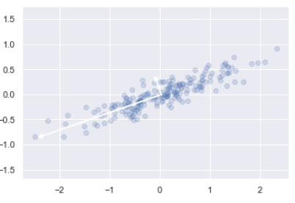
Principle components
Two-dimensional data
Two principle components

Slide 12
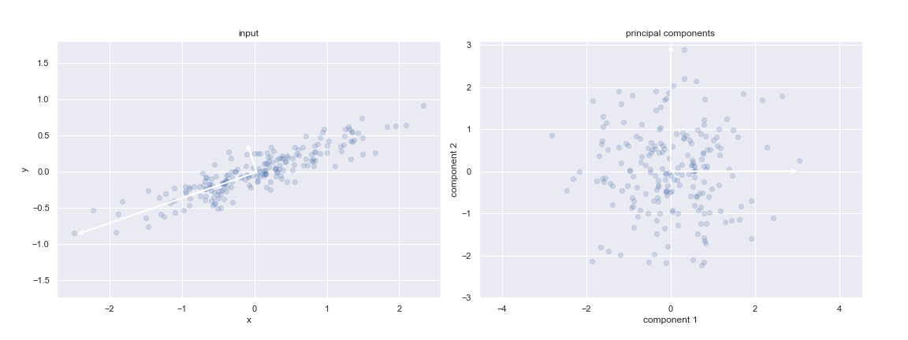
Data in PC coordinates

Slide 13
Explain in Python

Slide 14
PCA and linear algebra
PCs are the eigenvectors of the covariance matrix of the data
The direction in which there is no correlation

Slide 15
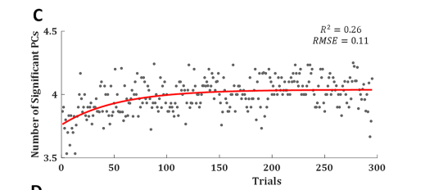
Number of PCs necessary increases
Number of PCs explaining more than 1% of the data
Haar Scientific Reports 2020 doi:10.1038/s41598-020-76805-9

Slide 16
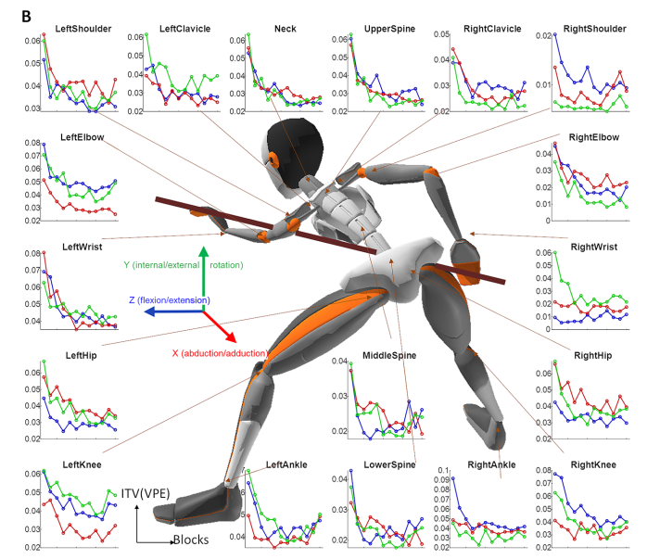
Variability for each subject decreases across all joints
Haar Scientific Reports 2020 doi:10.1038/s41598-020-76805-9

Slide 17
Part 2
Deep learning in studying movement

Slide 18
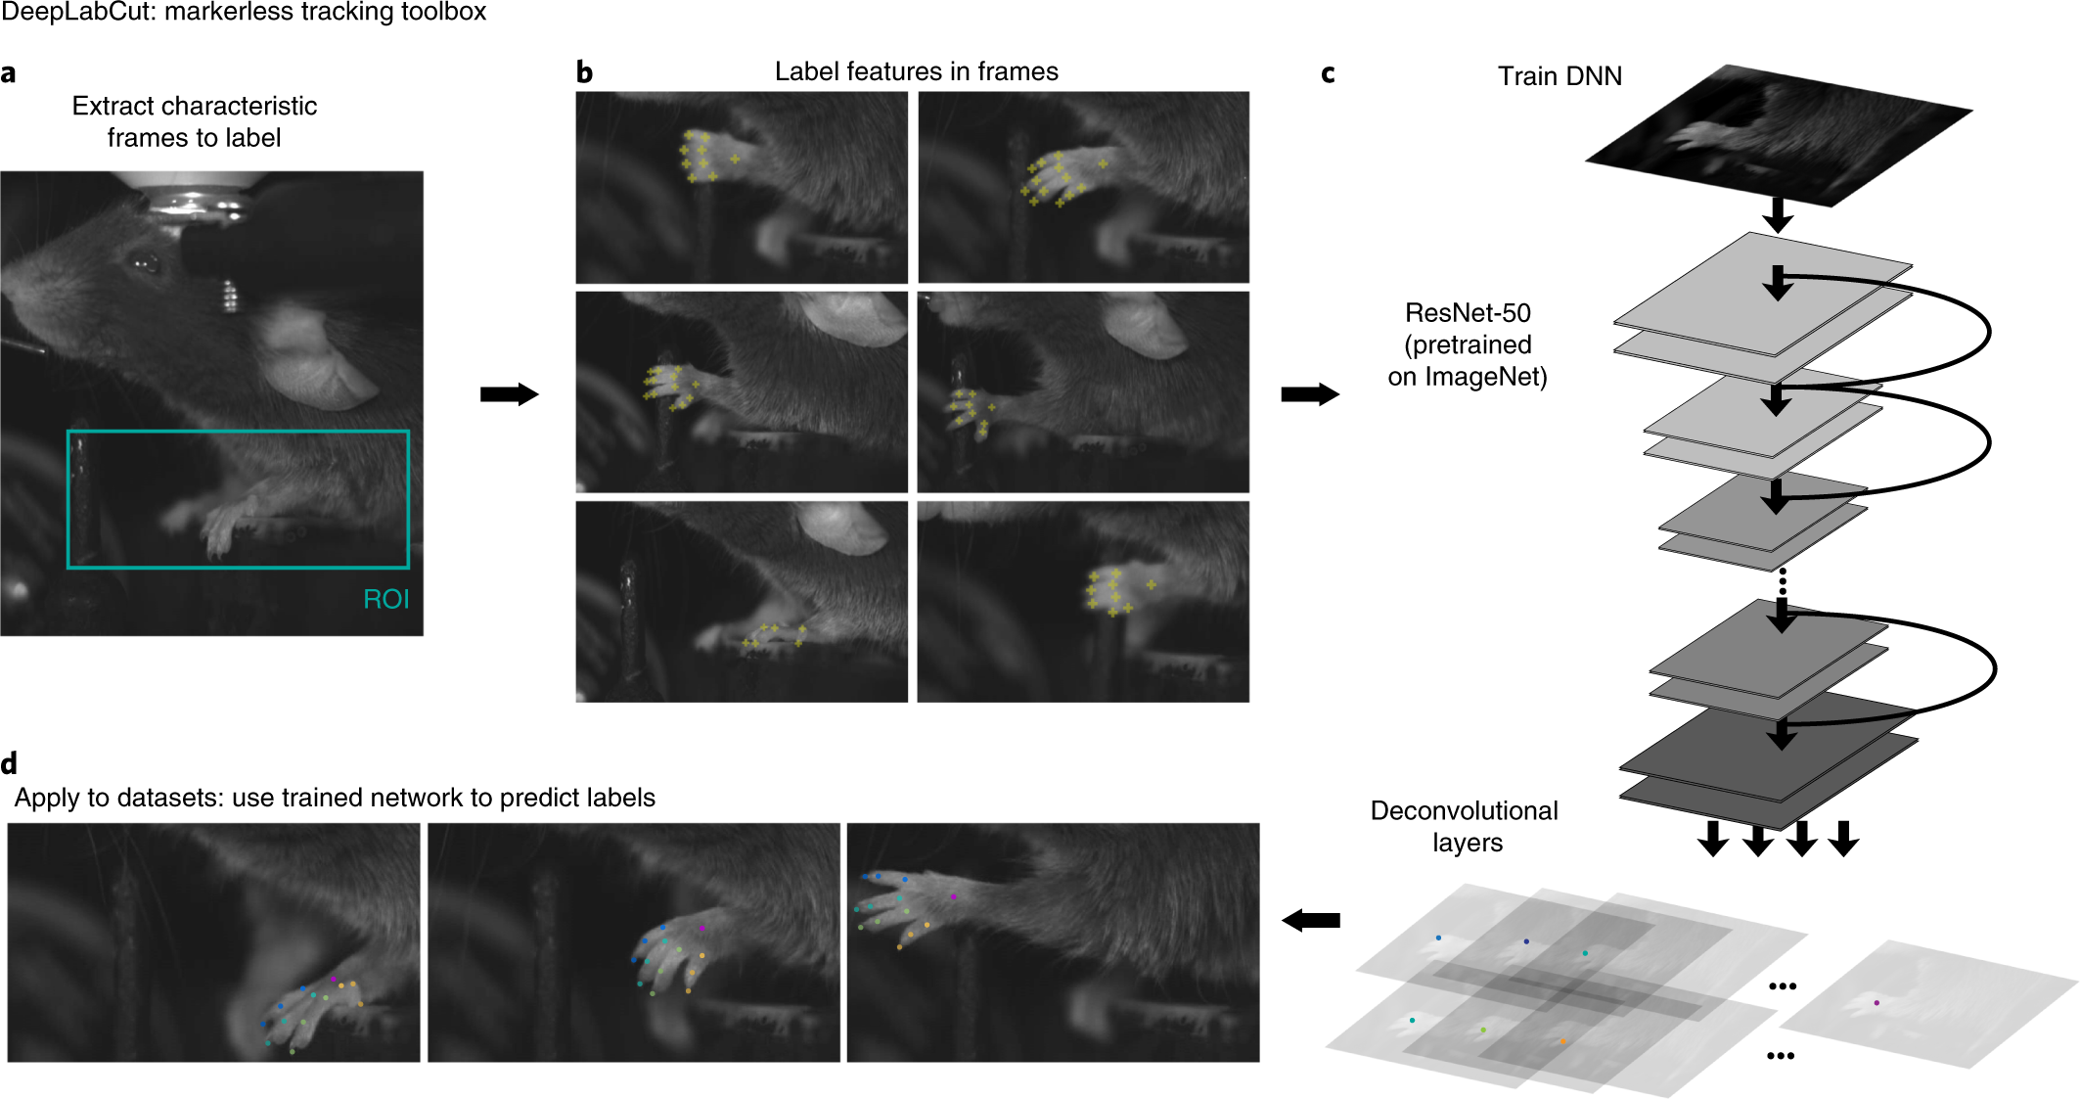
Deep learning requires training data
Mathis Nature Neuroscience 2018 doi:10.1038/s41593-018-0209-y

Slide 19
But training data can be generalized
Mathis Nature Neuroscience 2018 doi:10.1038/s41593-018-0209-y

Slide 20
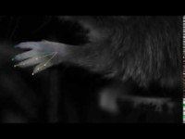
DeepLabCut open source software
DeepLabCut Mathis et al. https://www.youtube.com/watch?v=BFqyTALw9ms

Slide 21
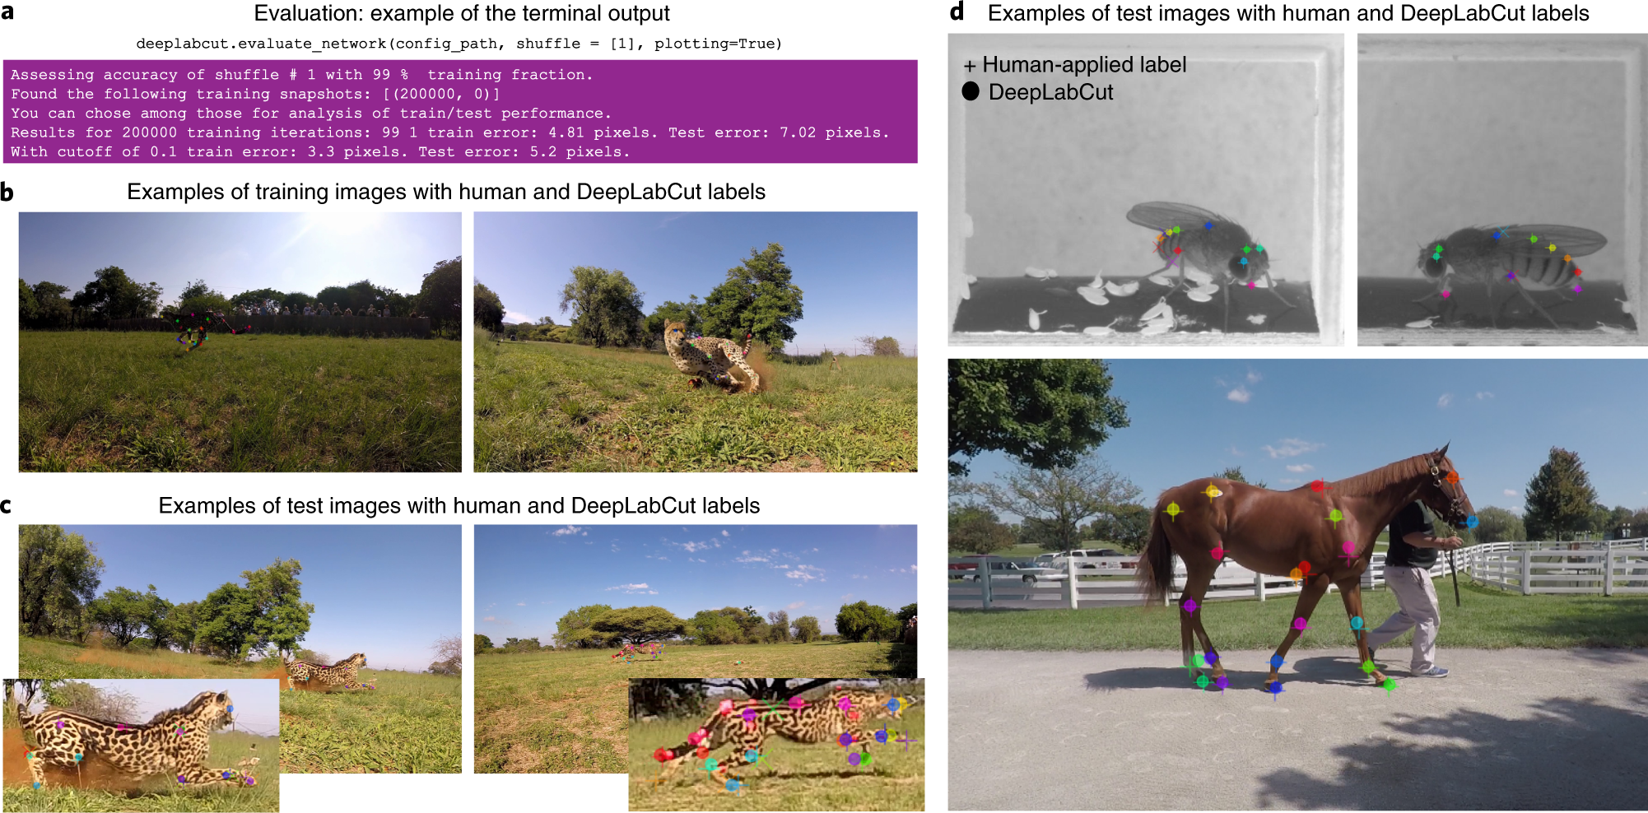
Can easily test quality
Nath Nature Protocols 2018 doi:10.1038/s41596-019-0176-0

Slide 22
Can easily test quality
Nath Nature Protocols 2018 doi:10.1038/s41596-019-0176-0

Slide 23
Can easily test quality
Nath Nature Protocols 2018 doi:10.1038/s41596-019-0176-0

Slide 24
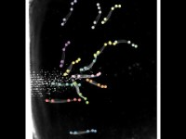
Multi-animal
DeepLabCut multi-animal DeepLabCut 2.2 (rc1) https://www.youtube.com/watch?v=uwyAl_P0HJk

Slide 25
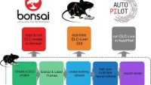
Real time
DeepLabCut DeepLabCut-Live!
https://www.youtube.com/watch?v=KDSgddOqHtM

Slide 26
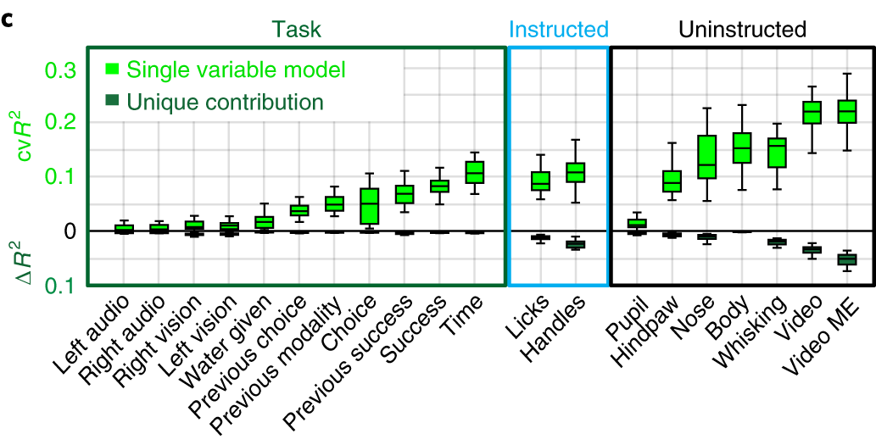
Brain activity dominated by non-instructed movements
Musall Nature Neuroscience 2019 doi:10.1038/s41593-019-0502-4

